Slide 1

School of Computing
Vel Tech Rangarajan Dr. Sagunthala R&D Institute of Science and Technology
Department of Computer Science and Engineering
10211CS224 / FULL STACK APPLICATION DEVELOPMENT (JAVA)
PROJECT REVIEW : MILESTONE PROJECT – 1
Date: 24-03-2026
Academic Campus Event & Registration Portal
SDG: SDG 9 –Industry, Innovation and Infrastructure
Presented By:
I.K.SIDDHARTHA – VTU26518–23UECS0972
Courses Handling Faculty:
Dr. Hafizur Rahman

Slide 2
INTRODUCTION
Real-time event synchronization is the process of instantly updating multiple systems when an event occurs.
It ensures that all connected applications or devices stay consistent and up to date.
An event can be any action such as a user click, transaction, message, or sensor update.
When an event happens, it is immediately detected and transmitted to other systems.
The systems process the event and update their data without noticeable delay.
It commonly uses event-driven architecture and message brokers like Apache Kafka.
This approach improves responsiveness, coordination, and The Academic Campus Event & Registration Portal is a web-based platform designed to manage and organize campus events efficiently.
It provides a centralized system for creating, publishing, and managing academic and non- academic events such as seminars, workshops, symposiums, conferences, technical fests, and cultural programs.
The portal allows students to browse available events and register online easily.It eliminates manual paperwork and reduces administrative workload.
The system ensures secure user authentication for students and administrators.
It provides real-time updates about event schedules, registration status, and announcements.The platform maintains accurate digital records of event participation.
It improves communication between event organizers and students.
The portal is designed to be user-friendly, responsive, and accessible from any device.
Overall, it enhances efficiency, transparency, and participation in campus events.user experience.
It is widely used in chat apps, online gaming, stock trading, and IoT systems.
1
2
3
4
5
6
7
8
9

Slide 3
PROBLEM STATEMENT
1
2
Problem defination_- Academic Campus Event & Registration Portal
In many colleges and universities, campus events are managed manually through paper-based registrations, spreadsheets, notice boards, and informal communication channels such as emails and messaging groups. This fragmented approach often leads to miscommunication, data loss, duplication of entries, and lack of proper coordination between students and organizers. Students may miss important announcements or deadlines due to the absence of a centralized information system.
Event organizers face challenges in tracking registrations, managing participant limits, verifying eligibility,
and generating reports. Maintaining historical records of events and participant data becomes difficult without a structured digital database. Additionally, manual systems consume more time, increase administrative workload, and are prone to human errors.
Therefore, there is a need for an integrated, secure, and user-friendly digital platform that can streamline event management, improve communication, ensure accurate record-keeping, and enhance overall efficiency in organizing academic campus events.
3
4
5
6
7
8
9

Slide 4
OBJECTIVE(S)
1
2
To develop a centralized digital platform for managing campus events efficiently.
To simplify and automate the event registration process for students.
To reduce paperwork and administrative workload through digital record management.
To provide real-time updates and improve communication between organizers and students.
To ensure secure, transparent, and accurate tracking of event participation data.
3
4
5
6
7
8
9

Slide 5
PROPOSED SYSTEM
The system is a centralized web-based platform for managing all campus events digitally.
It allows administrators to create, update, delete, and publish event details such as date, time, venue, description, and participant limits.
Students can securely register, log in, browse upcoming events, and register online.
The system provides instant registration confirmation and real-time updates.
It maintains a structured digital database to store event and participant records. Ø Role-based access control ensures secure access for administrators and students. Ø The portal enables real-time tracking of registrations and participant limits.
Automated notifications and announcements keep students informed about important updates.
The system generates reports and maintains historical event data for future reference
1
2
3
4
5
6
7
8
9

Slide 6
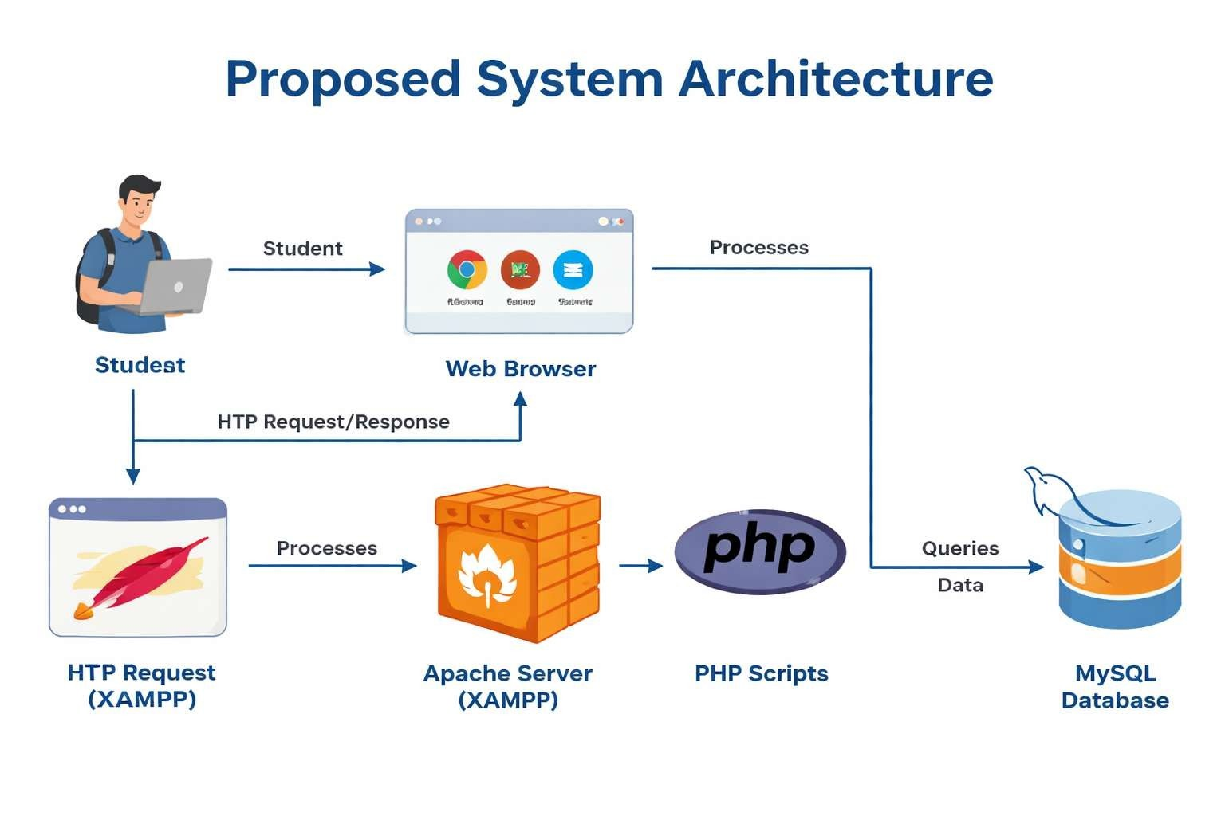
PROPOSED SYSTEM ARCHITECTURE
1
2
3
4
5
6
7
8
9

Slide 7
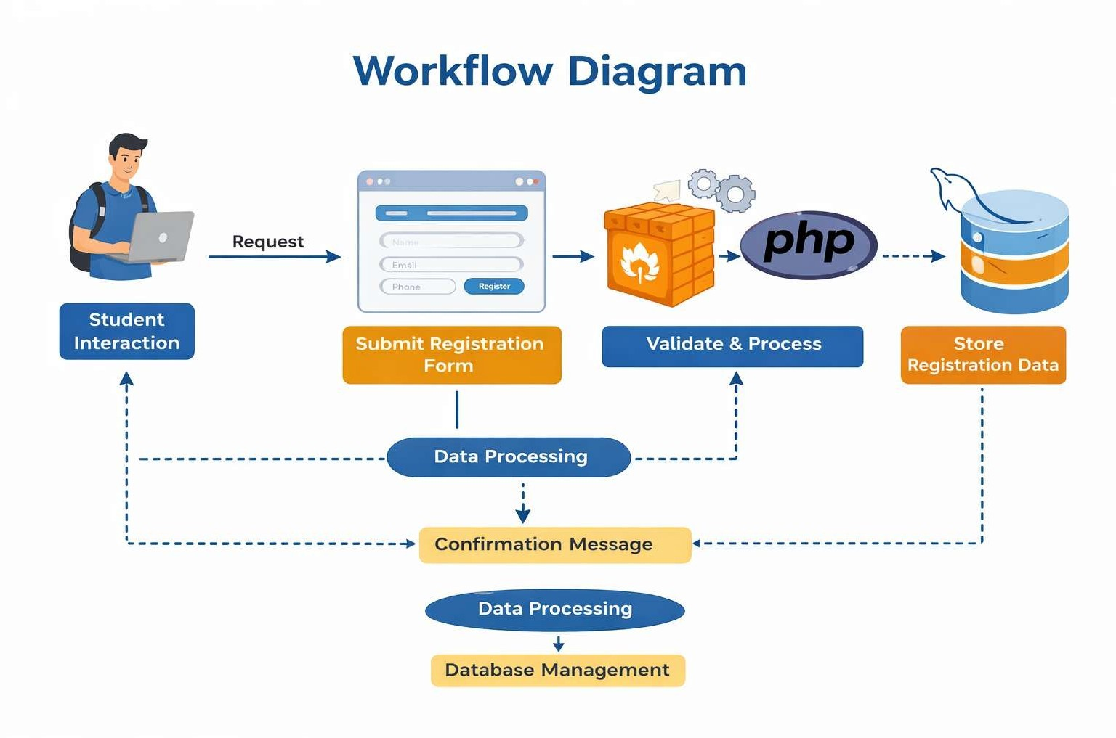
WORKFLOW
1
2
3
4
5
6
7
8
9

Slide 8
TECHNOLOGIES USED
Frontend Technologies
HTML5 – Structure of web pages
CSS3 – Styling the web pages (layout, colors, design)
JavaScript – Client-side validation (form validation, alerts) Bootstrap – Responsive design and UI components (optional) Backend Technologies
PHP – Server-side scripting and backend development MySQL – Database for storing event and registration data phpMyAdmin – Database management tool
Apache Server (XAMPP) – Local server to run PHP and MySQL
Database
MySQL – Stores event details, student details, registrations
SQL – Used for database queries (INSERT, SELECT, UPDATE, DELETE)
Tools & IDE
XAMPP – Local server environment (Apache + MySQL) VS Code / Notepad++ – Code editor for PHP, HTML, CSS phpMyAdmin – Database management
Web Browser (Chrome/Edge) – Running the application
Web Server
Apache HTTP Server (XAMPP) – Used to deploy and run the PHP application locally
Other Technologies
HTTP Protocol – Communication between client and server CRUD Operations – Create, Read, Update, Delete operations Form Handling – Collecting user input and storing in data
1
2
3
4
5
6
7
8
9

Slide 9
MODULE DESCRIPTION
1. Admin Module
The admin module allows the administrator to add, update, and delete event details. Admin can view student registrations and manage event information.
This module controls the overall system and maintains event data.
1
2
2. Student Module
The student module allows students to view available events. Students can select events and fill the registration form.
This module helps students to participate in campus events easily.
3
4
3. Event Management Module
This module is used to create and manage event details.
It stores event name, date, time, and location in the database. It helps in organizing and scheduling campus events.
5
6
4. Registration Module
This module allows students to register for events.
Student details like name, email, and phone number are stored in the database. It confirms successful registration after form submission.
7
8
5. Database Management Module
This module manages the database operations.
It stores and retrieves event and registration data from MySQL database. It ensures data is stored securely and efficiently.
9

Slide 10
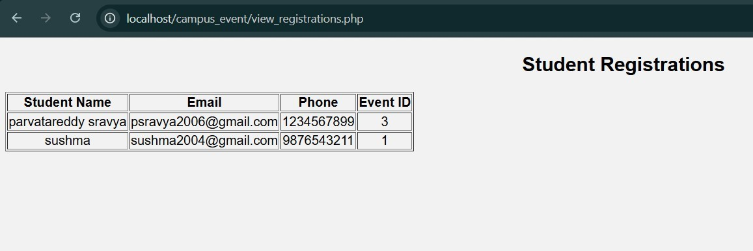
IMPLEMENTATION SCREENSHOTS
1
2
3
4
5
6
7
8
9

Slide 11
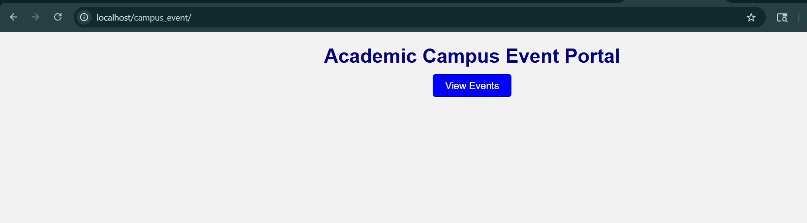
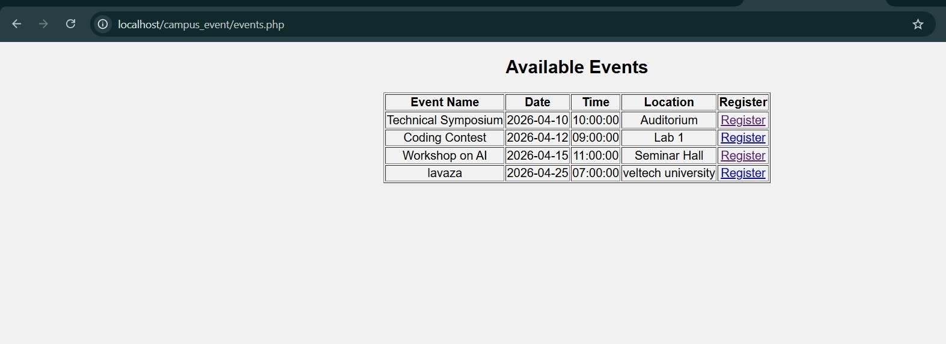
IMPLEMENTATION SCREENSHOTS
1
2
3
4
5
6
7
8(A)
9

Slide 12
ADVANTAGES & LIMITATIONS
1
Advantages:
Provides a centralized platform for managing all campus events.
Reduces manual paperwork and administrative workload.
Enables quick and easy online event registration for students.
Ensures secure login with role-based access control.
Provides real-time updates on event details and registration status.
Maintains accurate digital records of events and participants.
Improves communication between organizers and students.
2
3
4
5
6
Limitations:
7
Requires stable internet connectivity to access the portal.
Initial development and setup cost may be high.
Requires basic technical knowledge for system maintenance.
Data security risks if proper security measures are not implemented.
System downtime may affect event registration processes.
Requires regular updates and maintenance for smooth functioning.
8
9

Slide 13
Thank you

